Slide 1
Executive in an Executive Team
Nancy M. Smith, M.A., R.C.C.
Thursday, September 15, 2022

Slide 2
Land Acknowledgement
Land Acknowledgment:
“We respectfully acknowledge that we are on the treaty and traditional territory of the Michi Saagiig Anishinaabeg. We offer our gratitude to the First Peoples for their care for, and teachings about, our earth and our relations. May we honour those teachings.” (https://www.trentu.ca/fphl/)
We begin with a deep gratitude for the lands we are occupying to have this conversation; this is treaty land and colonized land.
We are grateful and privileged to be here; we recognize our responsibility for truth telling from the past and present to Indigenous people, First Nations Status, Non-Status, Metis, Inuit, and communities, and our responsibility to the land and to each other.
This acknowledgement is a start to deeper action.
To make us a safe or brave space, we ask that everyone be self-aware and to self-monitor to notice and interrupt comments about others that judge, shame, label, or attack.
To make this conversation safe, brave, we need to respectfully agree to disagree, to listen and to be open, and if we are successful, we can deepen our learning by hearing each other stories. (Dr. Deena Shaffer)

Slide 3
Confidentiality
Share the learning
Keep the specifics shared within your team
Pledge to maintain confidentiality, professionalism, and competitive advantage

Slide 4
Purpose
Acknowledge the journey here and the context within which we work
Raise awareness of key skills which adept (exceptional knowledge, proficient capacity) and adroit (dexterous, skillful, deft) project managers may display
Try to enrich our toolkit for flourishing (prospering, blossoming) as an executive in an executive team (versus as a student in a group for class) (Amy Edmondson teaming versus team)

Slide 5
Journey
“the great resignation”, COVID, changes in technology
“Burnout
Strong need to prove oneself
Keep working harder and harder to achieve proving oneself
Begin to neglect personal needs more
Feel conflicted and blame others/situation
Change personal values to focus on work more
Deny problems that arise due to work stress
Withdraw from social life/family/friends
Behaviour changes which upsets those closest
Depersonalization, don’t feel like oneself
Feel empty/numb
Feel depressed/lost/exhausted
Mental and physical collapse” from Faculty Focus August 12, 2022 https://www.facultyfocus.com/articles/faculty-development/finding-the-positive-your-mental-health-and-wellbeing-matter/?st=FFWeekly%3Bsc%3DFFWeekly220812%3Butm_term%3DFFWeekly220812&vgo_ee=J3aEH4yoazWA9DzoFnLAJf6RAh75nUo7gcyIyXc0xJM%3D

Slide 6
Present Context/Environment
Cloud culture
“Mutable Enterprise” (Martin Banks)
Ineffable profound change
Grief and loss
Chaos
Distractions and worry

Slide 7
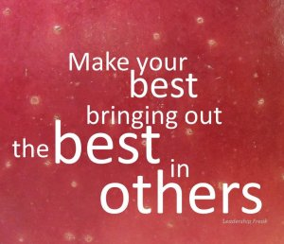
Executive Leadership
This Photo by Unknown Author is licensed under CC BY

Slide 8
How do we bring about the best in ourselves?

Slide 9
How do we bring out the best in our team members?

Slide 10
I LOVE IT HERE by Clint Pulver
Mentoring role
Confidence (etymology fidelity, “to trust” your own abilities)
Credibility (open to constantly improving knowledge, skills)
Competence (demonstrated application of knowledge, skills)
Candor (“fearless empathetic honesty”)
Caring (connection and respect)

Slide 11
Clint Pulver
Pre-pandemic “85 percent of working adults in the U.S. hate their jobs”
https://news.gallup.com/opinion/chairman/212045/world-broken-workplace.aspx (accessed 2022-09-14)
“millennials demand development over satisfaction”
“meaningful work…with other remarkable people”
“best for the world” rather than “best in the world”

Slide 12
Clint Pulver
The Iron Cowboy, James Lawrence “I did small things, consistently, over a long period of time.”
Ran 50 triathlons in 50 days in 50 different states

Slide 13
Francesca Gino
“constructive nonconformist”
Curiosity
“catalyst for job satisfaction, motivation, and high performance”
“fewer decision-making errors”
“lower group conflict”
“more open communication”
“better team performance”
“more diverse networks”
https://www.youtube.com/watch?v=GIr7cSXqcug

Slide 14
Francesca Gino
“Create the space to ask more questions”
“Model and invite question asking”

Slide 15
Powerful Questions
What questions
How questions
Rather than why or yes/no questions

Slide 16
Question Burst
Hal Gregerson, MIT
“collective problem-solving and fearless truth seeking”
1. set out a problem that is really on your mind
2. note how you feel about this problem
3. for two (2) minutes: write down only questions (NO solutions, NO answers) about this problem (no details, explanations, or preambles)
4. after the two (2) minutes is up, note how your feel about this problem now
https://www.youtube.com/watch?v=ATFxGSywAcU

Slide 17
How asking powerful questions can move us forward in our current environment

Slide 18
Cynefin Framework
From Welsh for habitat (pronounced kuh-NEV-in)

Slide 19
Complexity Framework – a way of looking at reality (versus a model seeks to represent reality) with blue diamond in the middle being Disorder (aware (aporetic) & confused, ontologically ignorant)
Unpredictable World
Predictable World
Complex (e.g. weather, unanticipated) Cause & effect relationship is unpredictable & does not repeat No right answers, managing polarities & dilemmas Emergent Practice: Problems & solutions evolve Enabling Constraints (heuristic) → Exaptive Practices (function not designed for e.g.old CDs as reflectors) Probe → sense → respond | Complicated Cause & effect are separated in time & space but can be researched, we can test things Open-ended problems with a range of possible answers Good practices Governing Constraints → Good Practices Sense → analyze → respond
Chaotic (e.g. earthquakes, wildfires, tornadoes, urgent, need for decisive leadership) No clear cause & effect relationship Crisis management, creative action Unclear what data is useful No Effective Constraints → Novel Practices Act → sense → respond | Simple/Clear/Obvious Cause & effect relationship is predictable & repeatable There are correct answers Best practices Rigid/Fixed Constraints → Best Practices Sense → categorize → respond
Longer Timeframe
Shorter
Timeframe

Slide 20
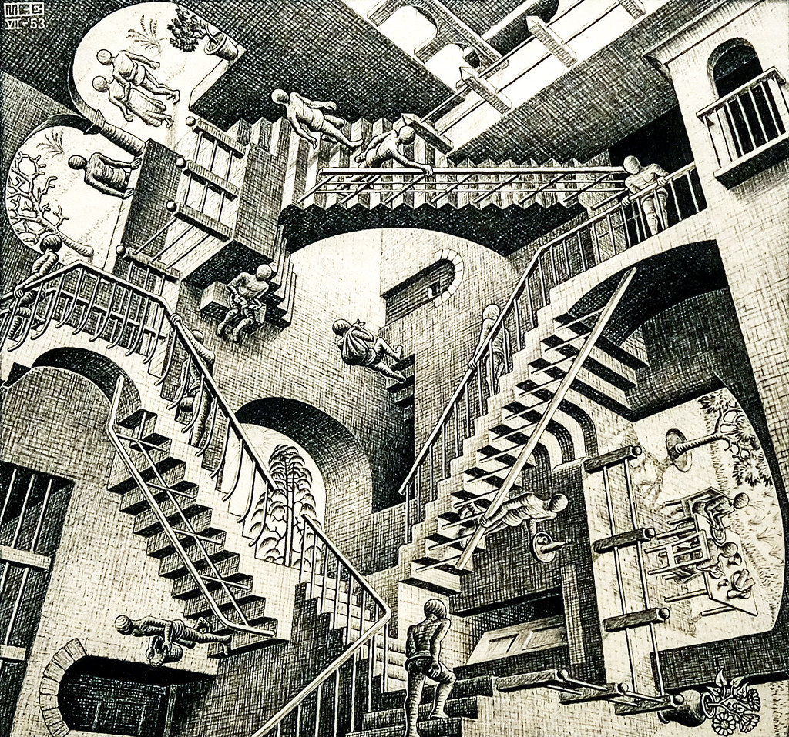
Today’s Context (Relativity by M. C. Escher)
This Photo by Unknown Author is licensed under CC BY

Slide 21
Given that change is faster and accelerating
David Goldsmith
Manage our attention
Deal with complexity
Use adversity to become better using a more holistic approach to create greater value for the organization and to develop the ecosystem
Make decisions with reflection – using curiosity, challenging our assumptions, seeing the bigger picture and patterns, and a longer timeframe (next week/month/trends/directionality)

Slide 22
John V. Petrocelli
Focus on genuine evidence, truth, and established knowledge that substantiates our reasoning and our decisions
Instead of the outcome, consider the best possible position to succeed
And we need to be clear about what outcome the product owner wants (clear and distinct from your personal outcome)

Slide 23
Dave Thomas
Goto Conference 2015
https://www.youtube.com/watch?v=a-BOSpxYJ9M
24:40 to 27:59
The PID Algorithm sometimes called the PID Controller (echo Model View Controller Construct)
Proportional (the error)
Integrative (the history integrated, bias)
Derivative (where it is and where it wants to be so anticipated change for the future)
Find out where you are (proportional, the error, determines which correction to apply, contextualized to environment)
Take a small step towards your goal (integrative)
Adjust your understanding based on what your learned (derivative, the difference)
Repeat
when faced with two or more alternatives that deliver roughly the same value, take the path that makes future change easier (because good design is easier to change in the future) [echo Stewart Brand’s Evolutionary Design]

Slide 24
Team Action

Slide 25
Strengthening Our Executive Team with curiosity and creativity
Introduce yourselves by only referring to 3 unique things about you – the ineffables (in other words, not job/where born/family info/job title/work)
Nancy will model

Slide 26
List of Potential Projects for the Next 8 Weeks
Brainstorm on back of your sheet

Slide 27
Select a Topic by Weighted Scoring high = yes/low = no
VALUE (high) with rationale/reason
Holistic re wider perspective and longer timeframe (high)/SCOPE/doable in 8 weeks
Easy to implement (high)/DELIVERABLES/easy to take small steps (high)/deconstructed with equitable distribution within the team
Easy to CHANGE/maintain after implemented (high)
COST (low)
Position to succeed (high)/team’s collective STRENGTH TO SUCCEED
RISK (low)

Slide 28
Break for 30 minutes to complete 3 tasks
Strengthen team with curiosity and creativity
Introduction 3 things unique to you
Brainstorm possible project ideas (one idea from each individual team member)
Complete the weighted scoring of the ideas on back of your respective team’s sheet by being curious and listening respectfully in the space and using the creative approach of being the best for the world

Slide 29
Debrief

Slide 30
Paper

Slide 31
Post It Notes

Slide 32
Silent Wall

Slide 33
Debrief
What did you notice?

Slide 34
Deliverable to Professor Northrop
List your team members
Include your team number
Top 5 project ideas
Prioritize this list

Slide 35
Another way to view your team topic
Chapter 19 Catalytic Questions, Be Less Zombie by Elvin Turner
Define the Outcome (example, Electronic Arts “Creative X”)
Identify Assumptions
Flip Reality
Chapter 26 Innovation Trapdoors
Desirable, Feasible, Viable (intersection of all 3)
“What Would Need to Be True…?”
Dream-Storming and Mare-Storming (“pre-mortem”)
4. Only…If…

Slide 36
Acknowledgement
Positive noticing (not praise, not flattery)
“I acknowledge…”

